Slide 1
End of Key Stage Two Assessments

Slide 2
End of Key Stage Two Assessments

Slide 3
What are end of key stage two assessments?
What you might know as SATs or Standard Attainment Tests, are national curriculum tests that are usually taken by children at the end of key stage two.
All children are assessed during the last term of year 6; for 2023, this is in the week beginning 8th May.
The aim of the tests is to establish whether pupils are working at an expected level in English and maths for the end of primary school and the start of secondary school.
The results of the tests do not tell us how accomplished children are in other areas, such as sport, music or art.
Pupils sit six different tests in three subject areas: maths, English reading and English grammar, spelling and punctuation.
English writing judgements are made by the pupils’ teachers through teacher assessment, based on evidence of independent writing gathered over the course of year 6.
There will be also be a science sampling in 2022/23 we have not be notified if we are a selected school yet.
Contents

Slide 4
When do they happen?
Every primary school will test their pupils on the same subject at the same time during the week beginning 8th May 2023. The schedule of tests for this year looks like this:
Assessment week 2022 | Tests
Tuesday 9th May | English grammar, punctuation and spelling Paper 1: questions Paper 2: spelling
Wednesday 10th May | English reading
Thursday 11th May | Mathematics Paper 1: arithmetic Paper 2: reasoning
Friday 12th May | Mathematics Paper 3: reasoning
Contents

Slide 5
What are the children tested on?
English
Grammar, Punctuation and Spelling
Paper 1: questions (45 minutes) 50 marks
A combined question and answer booklet which assesses pupils’ understanding of the grammar, punctuation and spelling elements of the national curriculum English programmes of study for key stage two.
Paper 2: spelling (15 minutes but not strictly timed) 20 marks
The paper that pupils receive has 20 sentences, each with a missing word. The teacher reads the sentences one at a time and pupils write in the missing word on their paper.
English
Reading
(1 hour) 50 marks
Pupils will have a reading booklet with three different texts to read and a corresponding question and answer booklet. The texts are presented in increasing levels of difficulty and pupils’ comprehension skills will be assessed against the comprehension elements of the English programme of study for key stage two.
Contents

Slide 6
What are the children tested on?
Mathematics
Paper 1: arithmetic (30 minutes) 40 marks
Pupils will have a booklet of arithmetic questions based on the national curriculum maths key stage two programmes of study.
Papers 2 and 3: reasoning (40 minutes each) 35 marks each
Both papers will ask children to reason and solve problems, again based on the national curriculum maths programmes of study.
Contents

Slide 7
How are the tests administered?
All test will be taken in school.
For the majority of children test will be taken in their usual classrooms.
We will also make use of some other rooms for smaller groups who may have extra time or support.
During the week we will provide a breakfast club for all year 6 children. Please can you ensure your children are in school by 8:15 am during this week.
Contents

Slide 8
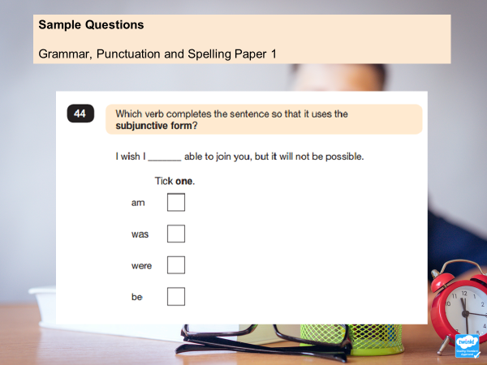

Slide 9
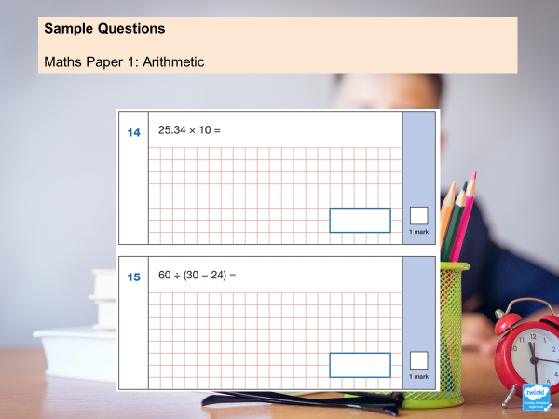

Slide 10
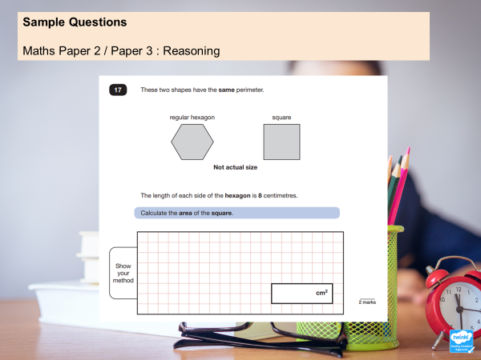

Slide 11
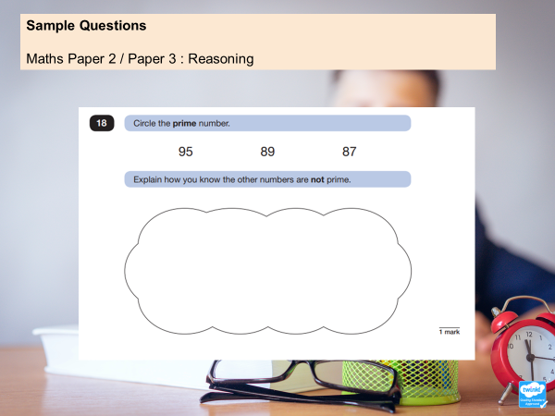

Slide 12

What happens with the results?
For 2023, school results in the end of key stage assessments will be published in performance tables.
School results will be shared with the school, their local authority or academy trust and Ofsted to support school improvement.
Each child will receive a scaled score for their performance on the tests. This is a score between 80 and 120, where a score of 100 is considered to be average or working at the expected level of attainment at the end of primary school.
We will share pupils’ results in their end of year written report, which is sent home to parents in July.
Contents

Slide 13
How can I help my child?
Support your child to complete any home learning tasks sent home, such as spelling activities, reading comprehensions and maths sheets. SATs revision booklets will be sent home.
Use online activities like Times Tables Rock Stars, to practise skills at home.
Make sure they go to bed at a reasonable time, have a good breakfast and arrive at school on time during the assessment week.
Encourage them to try their best, commend their efforts and plan to celebrate their hard work at the end of the testing week, rather than focusing on the test results.
Contents

Slide 14


