Slide 1
Animal Habitats

Slide 2

Breathing x3
Breathe in through the nose…hold for 3 seconds…and breathe out slowly and quietly through the mouth.

Slide 3
Ask permission to touch your partner

Slide 4

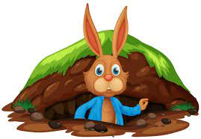
The Owl
Bonnie the Bunny lived in a burrow. She was feeling bored at home.
She wanted to live somewhere else. So, she visited her animal friends in their homes.

Slide 5

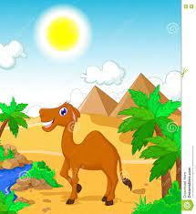
The Snake
Cassie the Camel lived in the dessert where it was very, very hot.
Cassie the Camel went to sleep standing up.

Slide 6


The Swan
Bonnie didn’t want to live there. She doesn’t like being too hot.

Slide 7
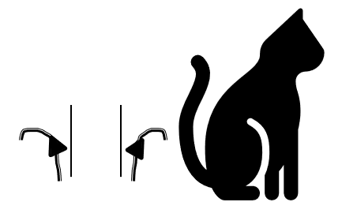
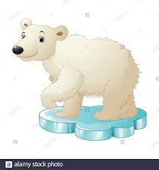
The Cat
Peter the polar Bear lived in the Arctic where it was very, very cold.
Peter had to wear a coat of very thick fur to stay warm.

Slide 8
The Swan
Bonnie didn’t want to live there. She doesn’t like being cold.

Slide 9

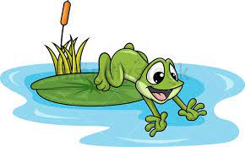
The Frog
Freddie the frog lived near a pond to keep his skin wet. Frogs eat insects like flies and moths.

Slide 10
The Swan
Bonnie didn’t want to live there. She doesn’t like eating insects.

Slide 11

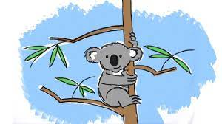
The Butterfly
Katie the Koala lived at the top of a tree in a forest. Katie’s favourite food was leaves from the tree. She ate lots and lots of leaves.

Slide 12
The Swan
Bonnie didn’t want to live there. She doesn’t like heights.

Slide 13
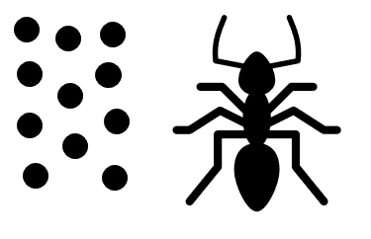
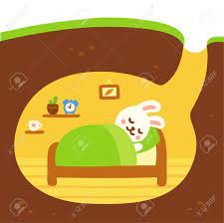
The Ant
“I like my home best” said Bonnie. “I don't want to live anywhere else.”
“My home keeps me safe.”

Slide 14
Say thank you to each other!

