Slide 1
Breathe and Be
Sensory Massage Poem

Slide 2
Ask permission to touch your partner

Slide 3

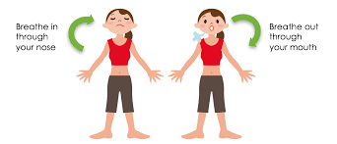
The Swan
I breathe slowly in, I breathe slowly out.

Slide 4

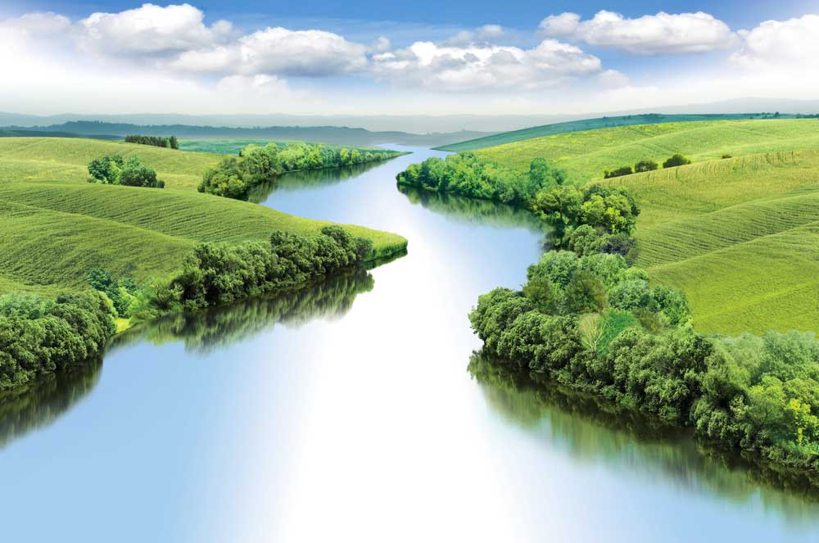
The Ant
My breath is a river of peace. I am here in the world.

Slide 5


The Ant
Each moment I can breathe and be.

Slide 6

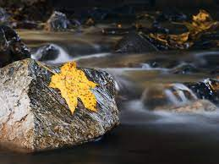
The Snake
I watch the stream, each thought is a floating leaf

Slide 7

The Ant
One leaf is a worry, one leaf is sadness. The leaves drift softly away.

Slide 8

The Butterfly
I breathe slowly in, I breathe slowly out.

Slide 9
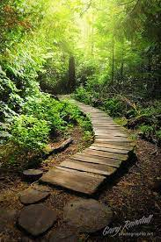
The Swan
My breath is a pathway of peace, moving softly through me.
Each day, I can breath and be.

Slide 10
Say thank you to each other!

