Slide 1
Feeling Anxious

Slide 2
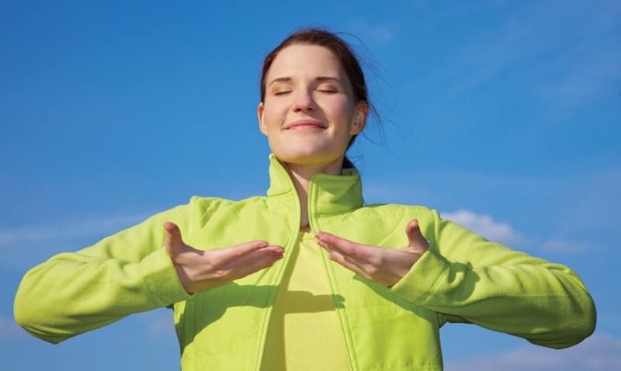
Breathing x3
Breathe in through the nose…hold for 3 seconds…and breathe out slowly and quietly through the mouth.

Slide 3
Ask permission to touch your partner

Slide 4

The Swan
Feeling worried is when we are worried or scared about what might happen or what other people think about us.

Slide 5

The Bear
It is normal to feel a little anxious when doing new things or going to new places.

Slide 6

The Butterfly
We might also feel anxious when we have to do something or say something in front of other people.

Slide 7
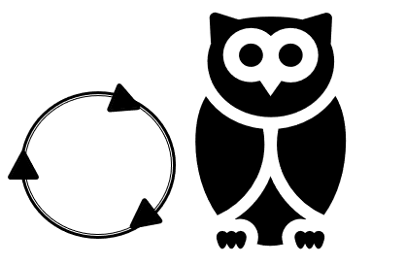
The Owl
We might worry that we will get something wrong and embarrass ourselves. This is OK!

Slide 8
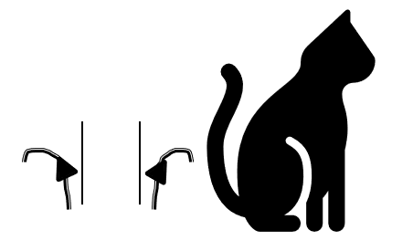
The Cat
Feeling anxious can sometimes be helpful. It makes us think carefully about what we are doing so that we get it right.

Slide 9

The Snake
Sometimes, we can worry too much about things that might go wrong and this can stop us from doing these things.

Slide 10
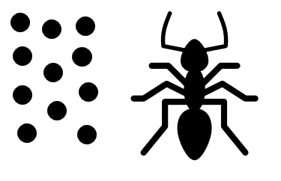
The Ant
Sometimes we can worry too much about what other people think and say about us.

Slide 11

The Frog
When we feel anxious it can sometimes help to try to think more about positive thoughts. We might think about the things that we like and enjoy. We might think about how we might feel when we have been successful.

Slide 12

The Elephant
It is ok to feel anxious sometimes but we can try to think positive thoughts and carry on doing things.

Slide 13
Say thank you to each other!

