Slide 1
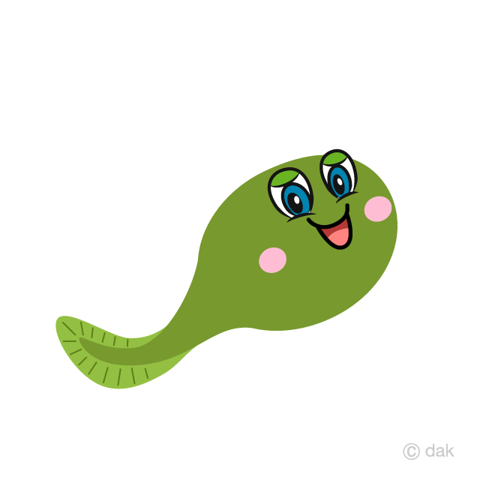
I’m A Little Tadpole

Slide 2
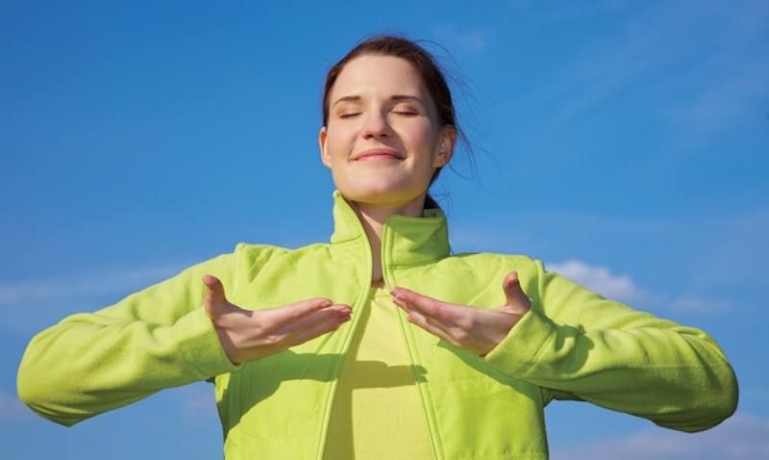
Breathing x3
Breathe in through the nose…hold for 3 seconds…and breathe out slowly and quietly through the mouth.

Slide 3
Ask permission to touch your partner

Slide 4

The Owl
I’m a little tadpole.

Slide 5

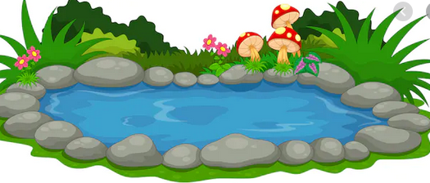
The Snake
Swimming in the pond.

Slide 6

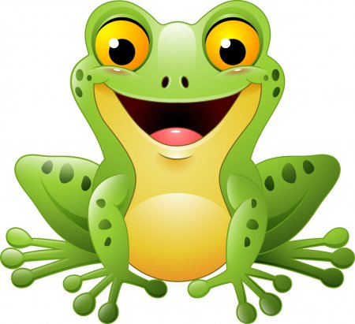
The Swan
Waiting to become a frog.

Slide 7

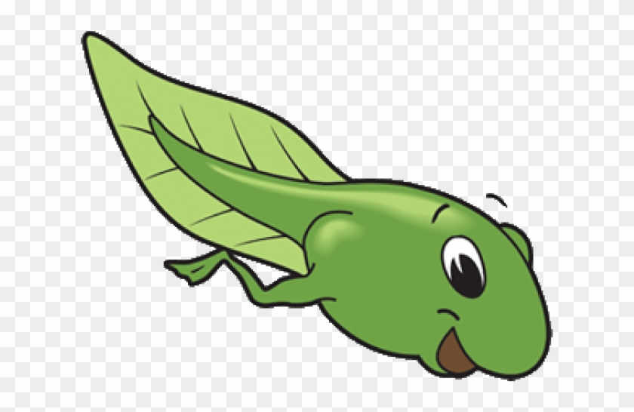
The Lion
First I’ll grow my back legs.

Slide 8

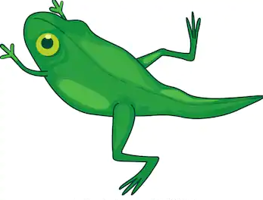
The Butterfly
Then I’ll grow my front.

Slide 9


The Elephant
Lastly, my tail will fall off.

Slide 10

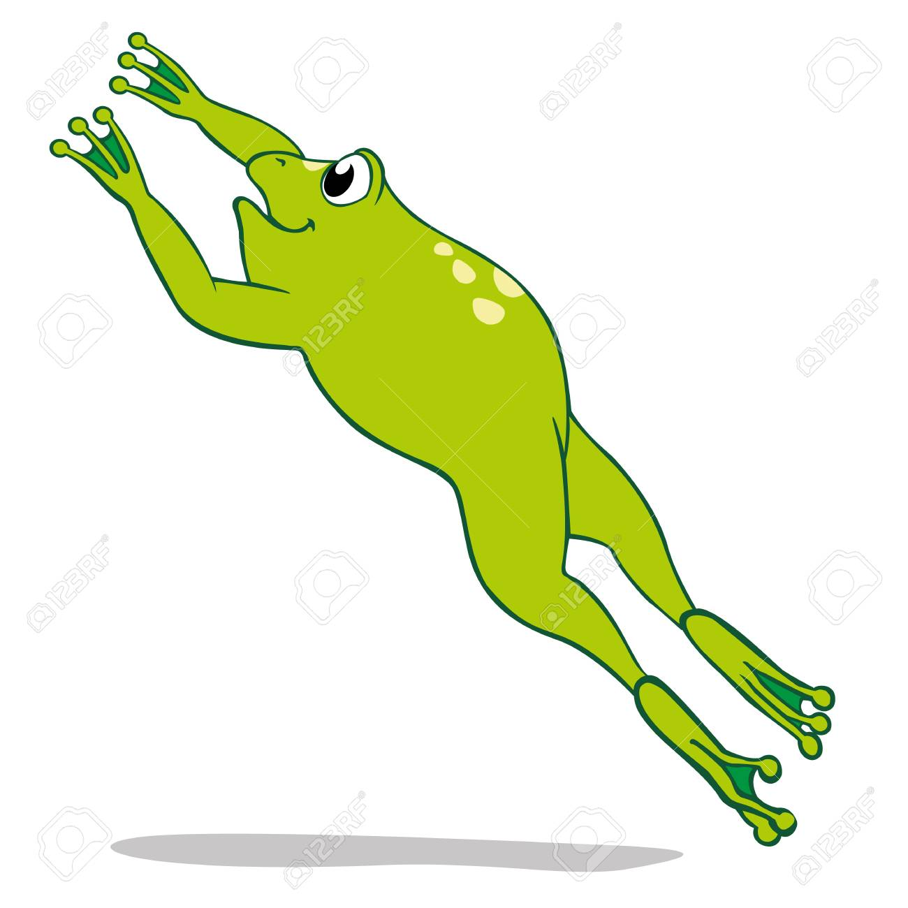
The Frog
And then I am ready to jump!

Slide 11
Say thank you to each other!

