Slide 1
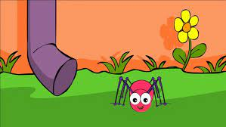
Incy Wincy Spider

Slide 2

Breathing x3
Breathe in through the nose…hold for 3 seconds…and breathe out slowly and quietly through the mouth.

Slide 3
Ask permission to touch your partner!

Slide 4

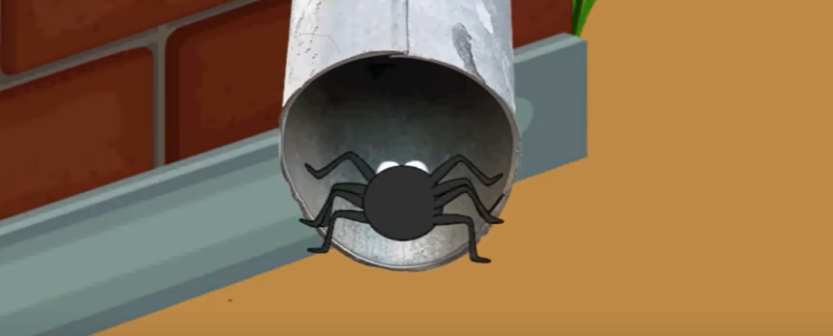
The Bear
Incy Wincy Spider climbed up the water spout

Slide 5

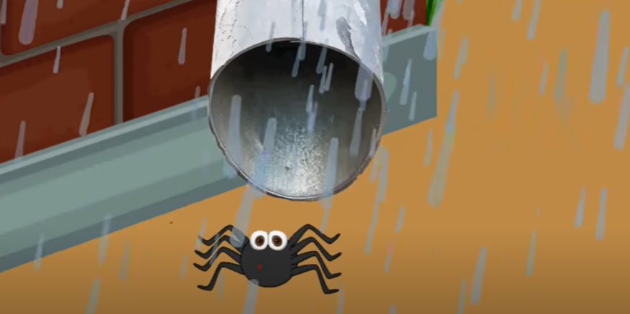
The Butterfly (down)
Down came the rain and washed the spider out

Slide 6

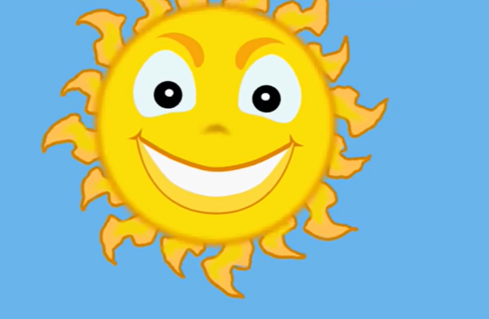
The Owl
Out came the sunshine and dried up all the rain

Slide 7

The Elephant
Now Incy Wincy Spider crawled up the spout again..

