Slide 1
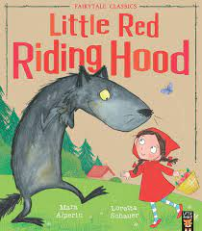
Little Red Riding Hood

Slide 2
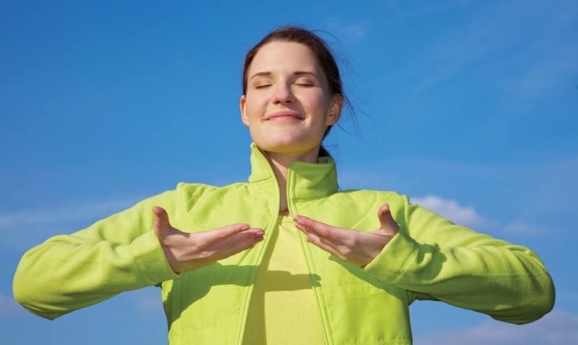
Breathing x3
Breathe in through the nose…hold for 3 seconds…and breathe out slowly and quietly through the mouth.

Slide 3
Ask permission to touch your partner

Slide 4
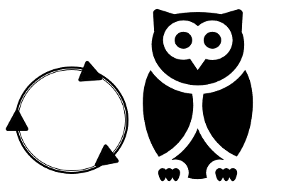
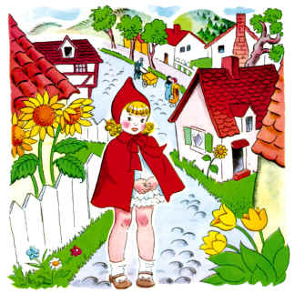
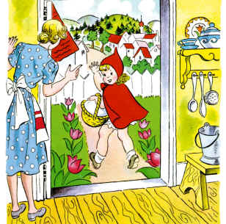
The Owl
Little Red Riding Hood lived in the woods with her mother. One day Little Red Riding Hood went to visit her Granny. She had a nice cake in her basket.

Slide 5

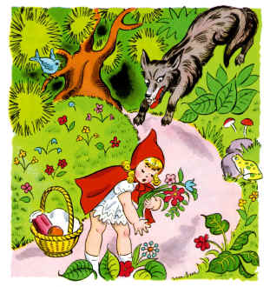
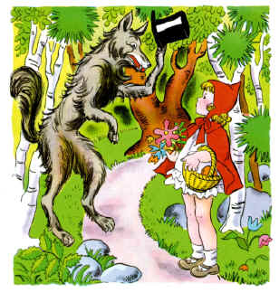
The Bear
On her way Little Red Riding Hood met a wolf. ‘Hello!’ said the wolf. ‘Where are you going?’ ‘I’m going to see my Granny. She lives in a house behind those trees.’

Slide 6

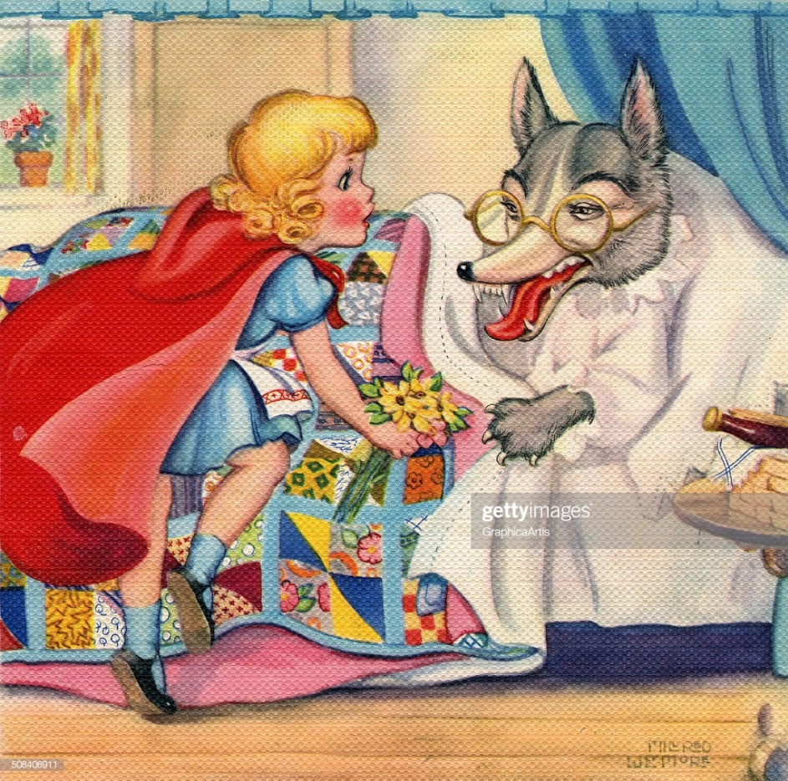
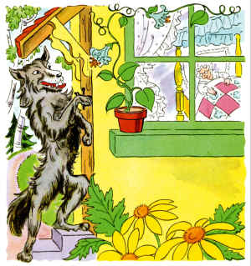
The Elephant
The wolf ran to Granny’s house and ate Granny up. He got into Granny’s bed. A little later, Little Red Riding Hood reached the house. She looked at the wolf.

Slide 7
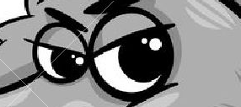
The Owl
‘Granny, what big eyes you have!’ ‘All the better to see you with!’ said the wolf.

Slide 8


The Frog
‘Granny, what big ears you have!’ ‘All the better to hear you with!’ said the wolf.

Slide 9
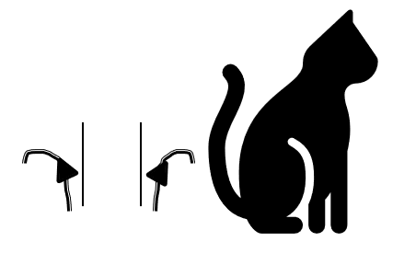
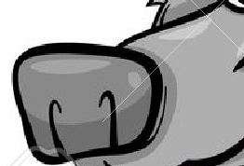
The Cat
‘Granny, what a big nose you have!’ ‘All the better to smell you with!’ said the wolf.

Slide 10


The Lion
‘Granny, what big teeth you have!’ ‘All the better to eat you with!’ shouted the wolf.

Slide 11
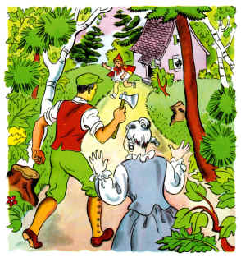
The Bear
A woodcutter was in the wood. He heard a loud scream and ran to the house.

Slide 12

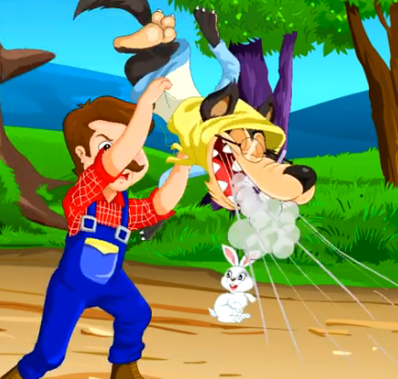
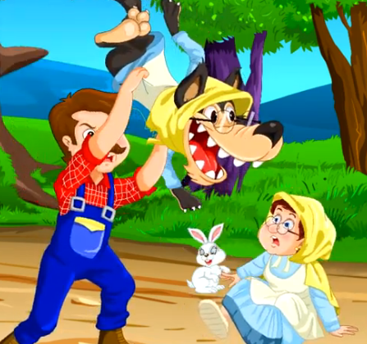
The Butterfly
The brave woodcutter picked up the bad wolf. He shook him and the Granny fell out.

Slide 13

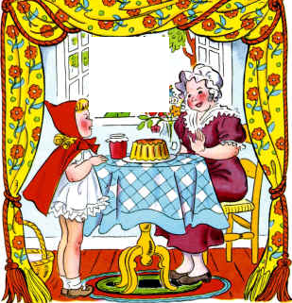
The Swan
The wolf ran away and Little Red Riding Hood never saw the wolf again. Granny and Little Red enjoyed their lunch together.

Slide 14
Say thank you to each other!

