Slide 1
Personal Space

Slide 2
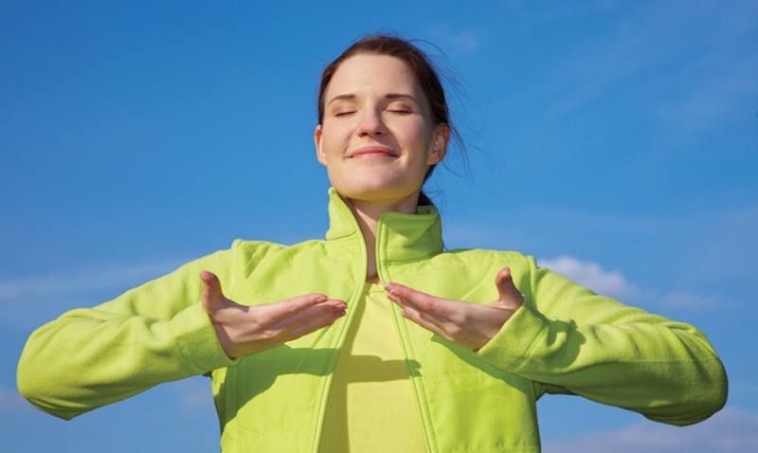
Breathing x3
Breathe in through the nose…hold for 3 seconds…and breathe out slowly and quietly through the mouth.

Slide 3
Ask permission to touch your partner!

Slide 4

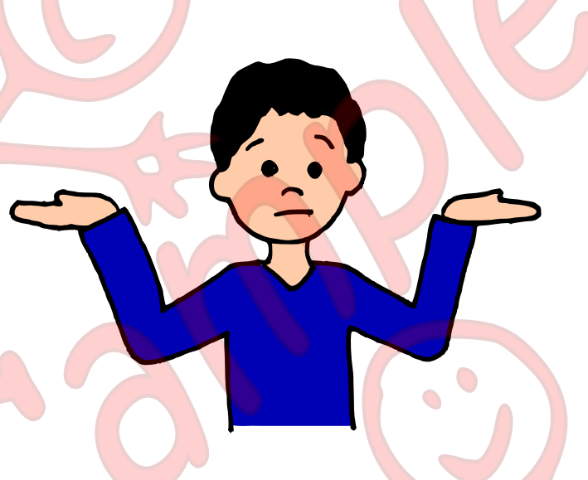
The Swan
What is personal Space?

Slide 5

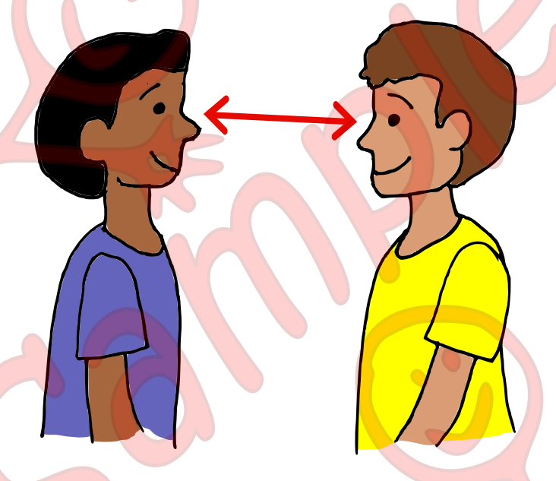
The Butterfly
Personal space is the distance that makes people feel comfortable.

Slide 6

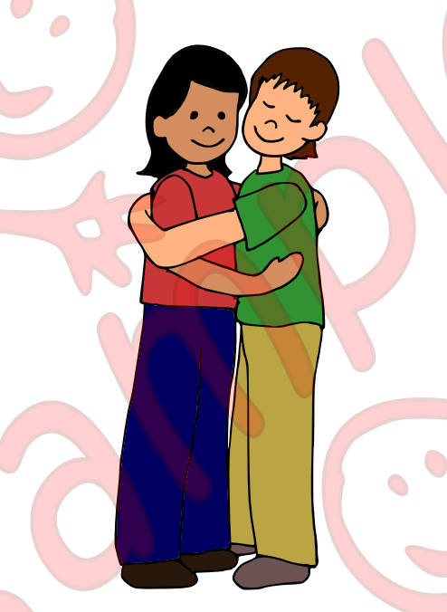
The Elephant
This is TOO close!

Slide 7

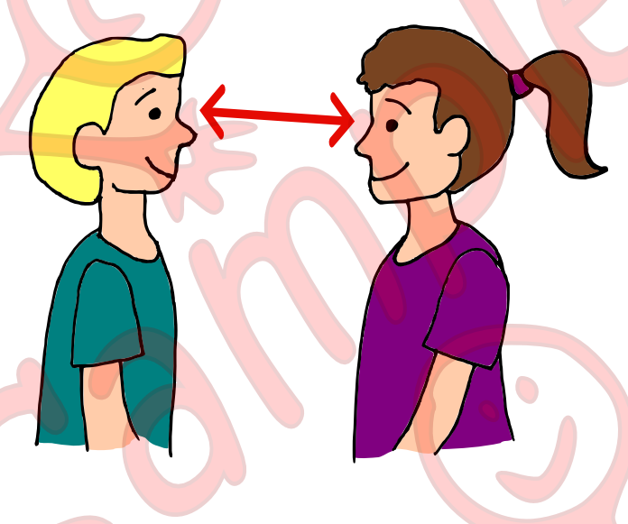
The Owl
This is just right!

Slide 8

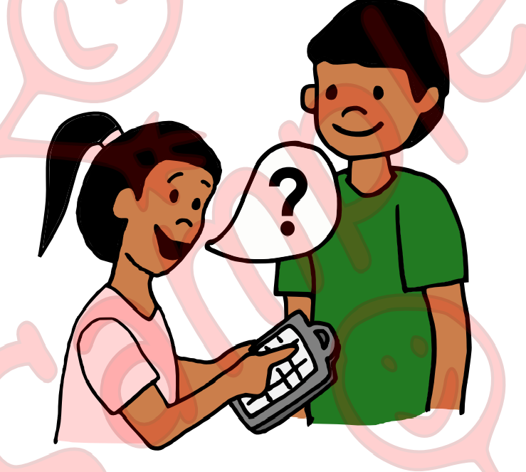
The Snake
What happens if I get too close?

Slide 9
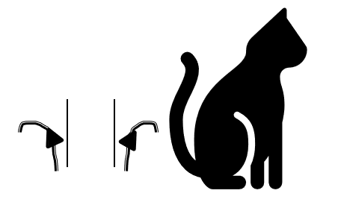
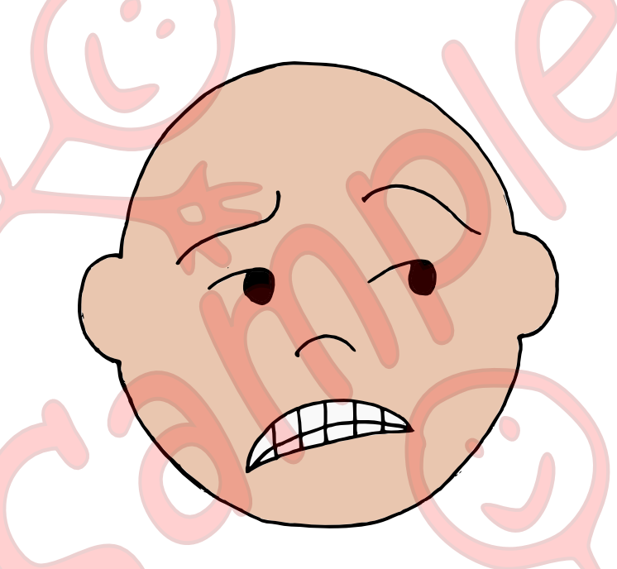
The Cat
People feel uncomfortable!

Slide 10
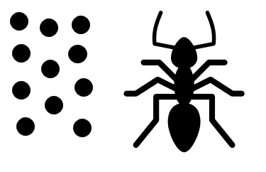
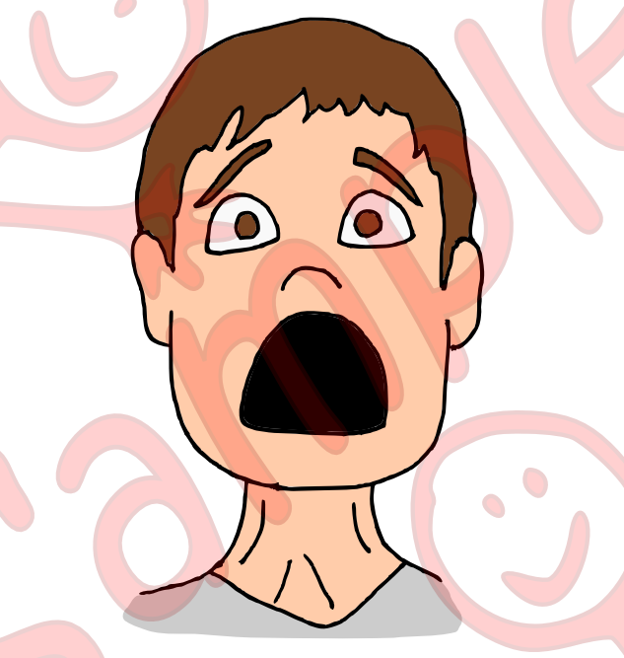
The Ant
People may feel scared

Slide 11

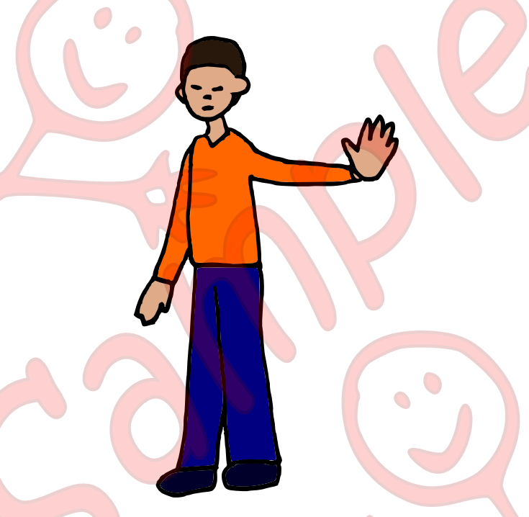
The Bear
And people might walk away from you

Slide 12
The Butterfly
What happens if I give people space?

Slide 13
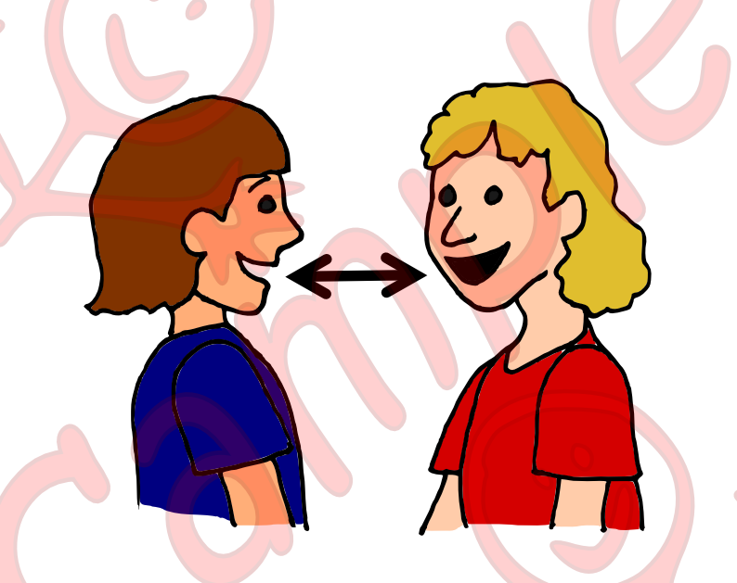
The Cat
People will be happy and talk to me

Slide 14

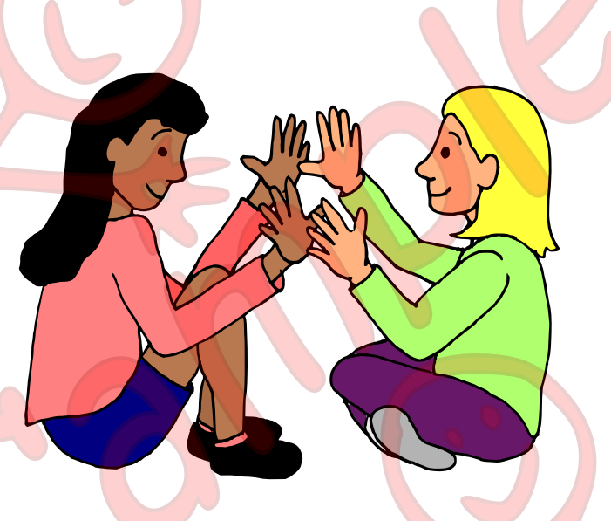
The Frog
People will play with me

Slide 15
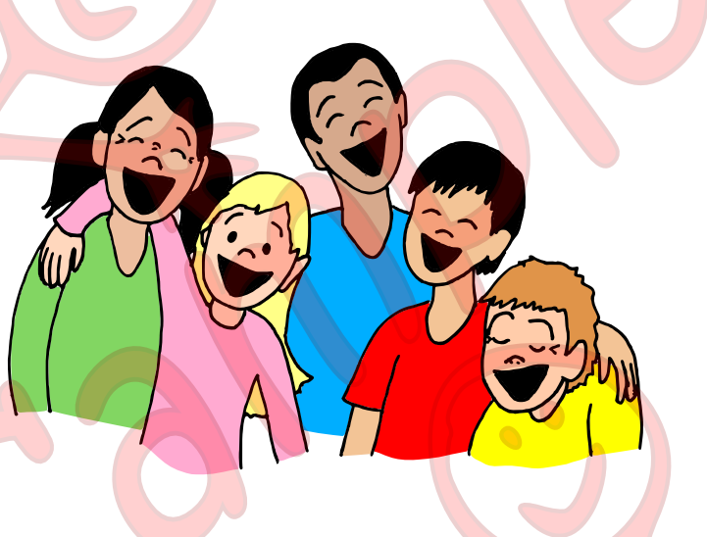
The Owl
I make lots of friends!

Slide 16
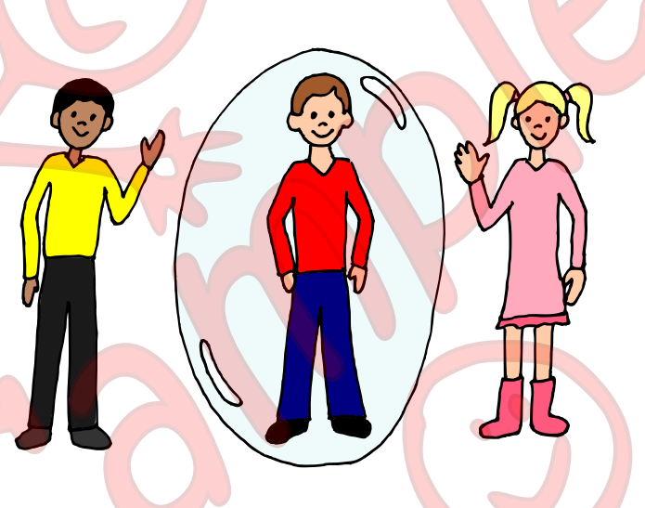
The Swan
Now I know what to do and what personal space is

Slide 17
Say thank you to each other

