Slide 1
Staying Calm

Slide 2

Breathing x3
Breathe in through the nose…hold for 3 seconds…and breathe out slowly and quietly through the mouth.

Slide 3
Ask permission to touch your partner!

Slide 4


The Elephant
Sometimes I get frustrated and angry!

Slide 5

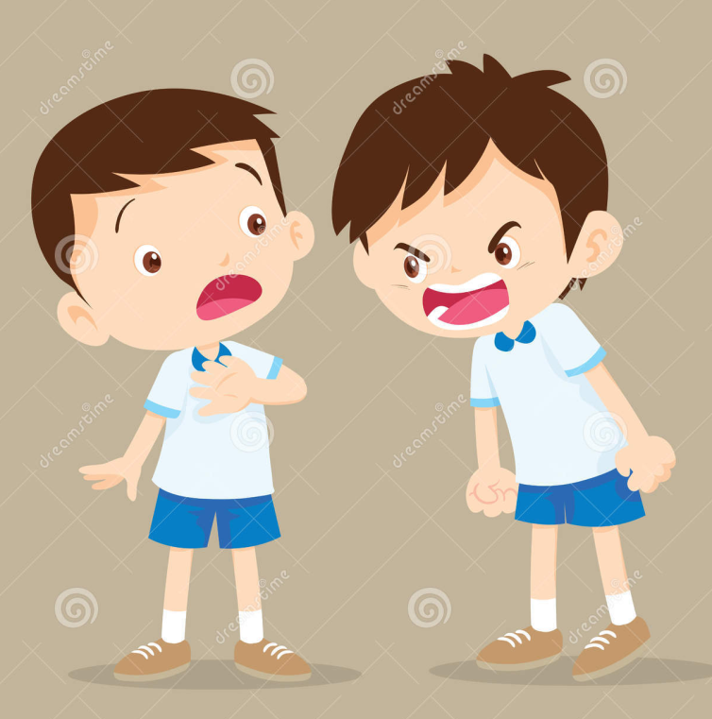
The Frog
When I am angry, sometimes I want to shout, throw things and hurt my friends/family.

Slide 6


The Owl
If I act this way, it makes mummy, my teachers and friends sad.

Slide 7


The Butterfly
When I am angry I need to take a deep breath!

Slide 8

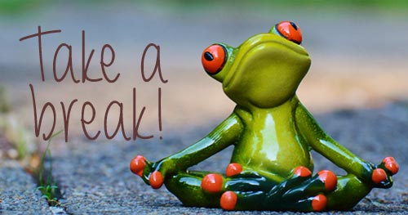
The Bear
And remember, I can ask to take a break to calm down.

Slide 9


The Calm
I tell people around me how I am feeling. I always use my words, and soon I will feel better!

Slide 10
Say thank you to each other!

