Slide 1

The Gingerbread Man

Slide 2

Breathing x3
Breathe in through the nose…hold for 3 seconds…and breathe out slowly and quietly through the mouth.

Slide 3
Ask permission to touch your partner

Slide 4

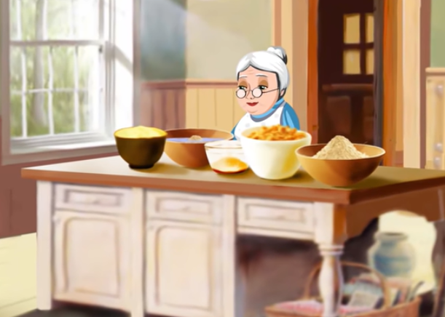
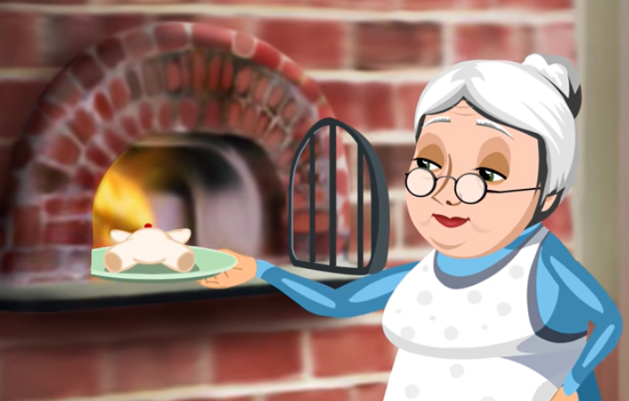
The Frog
A lady made a gingerbread man. She then put it into the oven to bake.

Slide 5

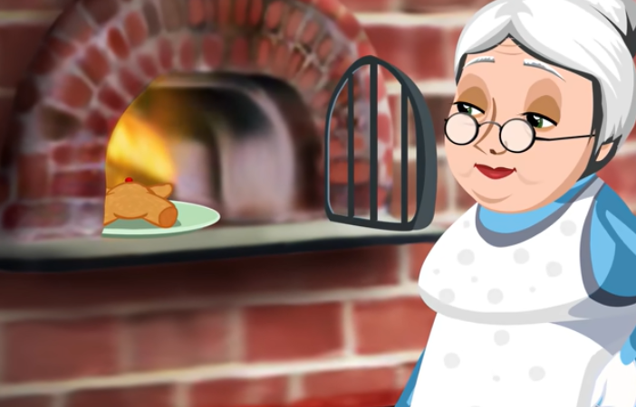
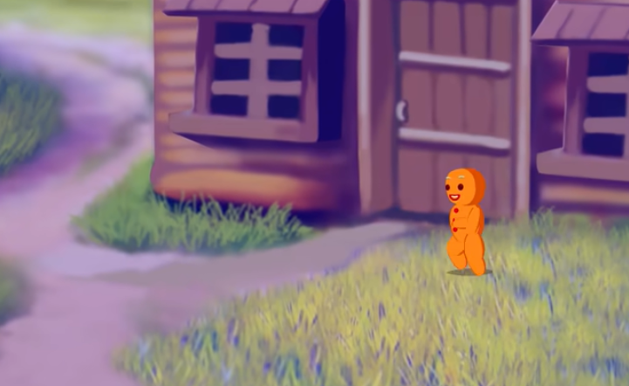
The Snake
The lady opened the oven door when the timer was ringing to so say it had finished baking.
The gingerbread jumped up and ran out of the oven, out of the window and off down the street.

Slide 6

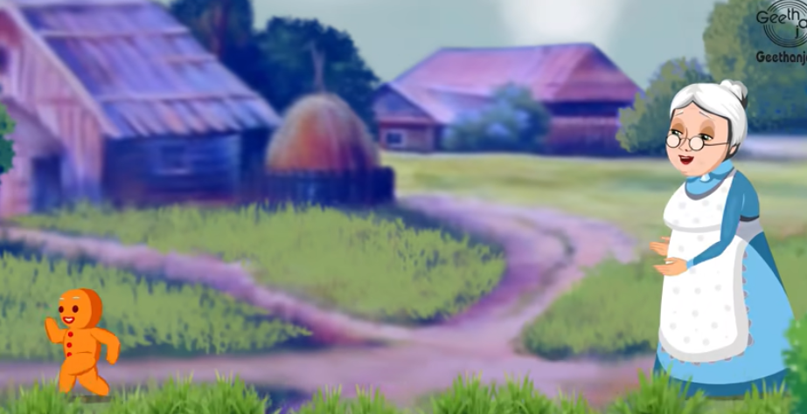
The Bear
The lady chased after the gingerbread man.
The gingerbread man shouted, “Run, run as fast as you can, you can’t catch me I’m the gingerbread man.”

Slide 7

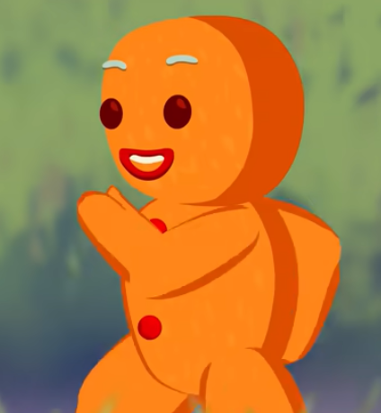
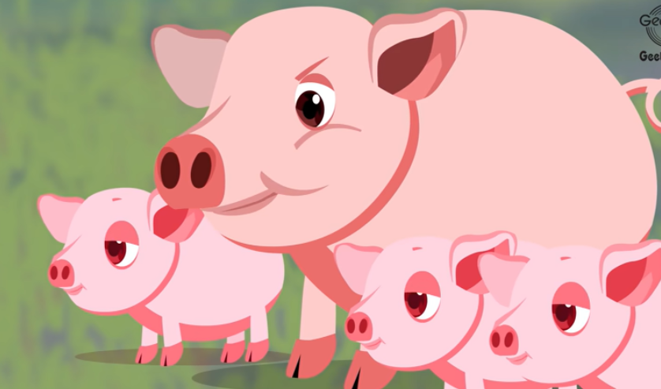
The Owl
A pig saw the gingerbread man and thought he looked a tasty treat so chased after him.
The gingerbread man shouted, “Run, run as fast as you can, you can’t catch me I’m the gingerbread man.”

Slide 8

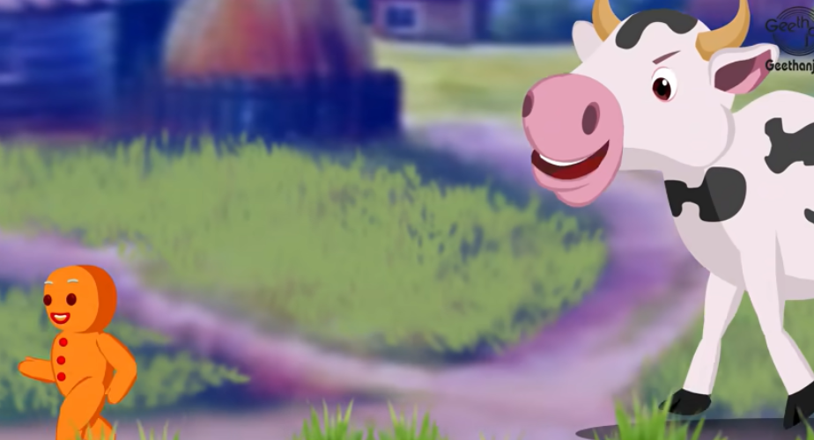
The Ant
A cow saw the gingerbread man and thought he looked a tasty treat so chased after him.
The gingerbread man shouted, “Run, run as fast as you can, you can’t catch me I’m the gingerbread man.”

Slide 9
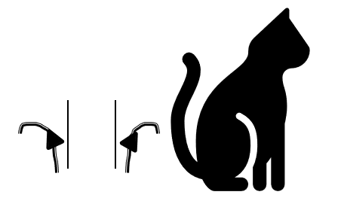
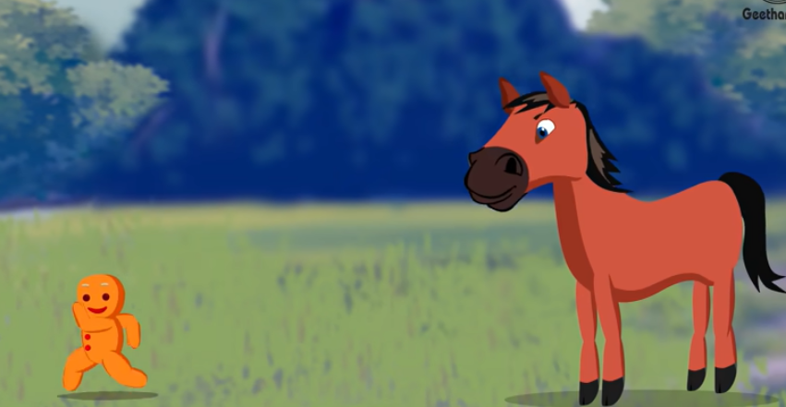
The Cat
A horse saw the gingerbread man and thought he looked a tasty treat so chased after him.
The gingerbread man shouted, “Run, run as fast as you can, you can’t catch me I’m the gingerbread man.”

Slide 10

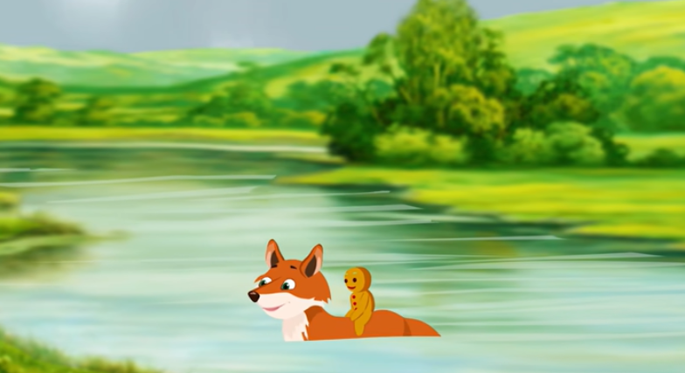
The Butterfly
The gingerbread man came to a riverbank and met a fox. The fox told the gingerbread man to climb onto his back and said he would swim him safely across the river.

Slide 11

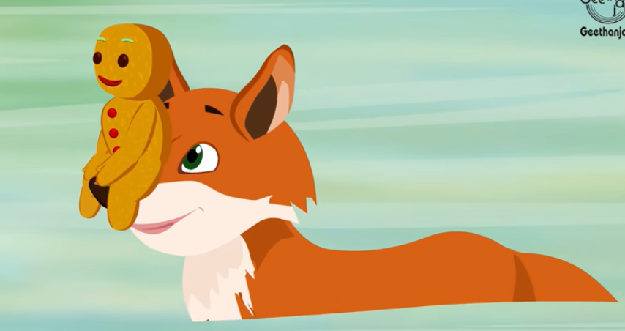
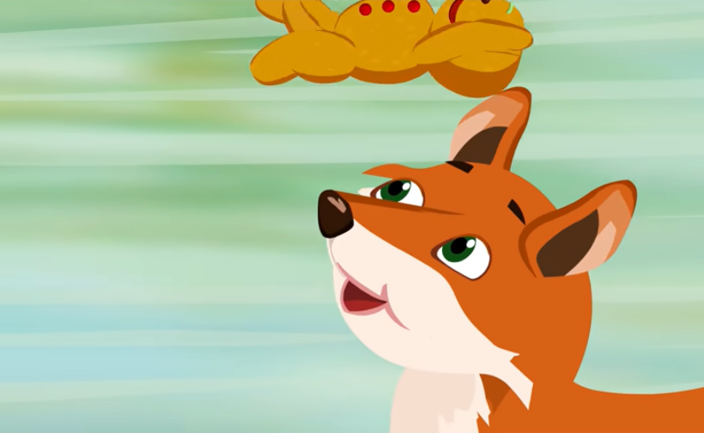
The Swan
The Fox asked the Gingerbread man to sit on his nose.
The gingerbread man was about to thank the fox, but the fox swished his head up making the gingerbread man fly into the air. The gingerbread man landed in the fox's mouth in one gulp. He was Yummy!!!

Slide 12
Say thank you to each other!

