Slide 1
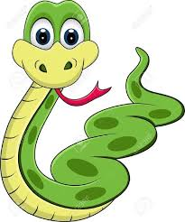
Sophie Snake Slithers Through The Rainforest

Slide 2

Breathing x3
Breathe in through the nose…hold for 3 seconds…and breathe out slowly and quietly through the mouth.

Slide 3
Ask permission to touch your partner

Slide 4

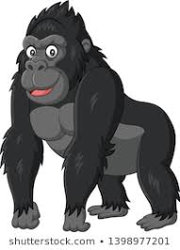
The Snake
Sophie Snake slithered through the rainforest.
She slithered up to Gorilla. Ssssssss

Slide 5

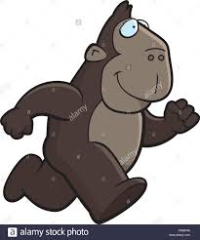
The Bear
But the Gorilla ran away. Stomp, stomp, stomp.

Slide 6
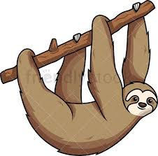
The Snake
Sophie Snake slithered through the Rain Forest
She slithered up to a sloth.. Ssssssss

Slide 7


The Butterfly
But the sloth slowly climbed away. Whoosh, whoosh, whoosh.

Slide 8
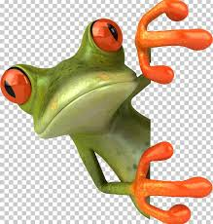
The Snake
Sophie Snake slithered through the Rain Forest.
She slithered up to a tree frog.. Sssssss

Slide 9

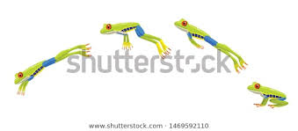
The Frog
But the tree frog jumped away. Bounce, bounce, bounce.

Slide 10
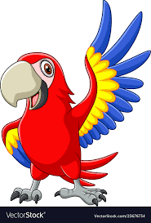
The Snake
Sophie Snake slithered through the Rain Forest.
She slithered up to a Macaw. ‘Ssssssss…
Sssssssorry,’ said Sophie Snake, ‘I scare all the other animals away.’

Slide 11
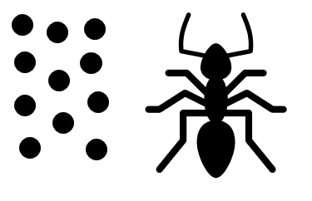
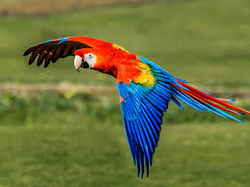
The Ant
So, Macaw flew around the rainforest and told all the animals that Sophie Snake was not really very scary.

Slide 12
The Snake
Sophie Snake slithered through the Rain Forest.
She slithered up to:
the Gorilla
the Sloth
the tree frog

Slide 13

The Calm
And they all played happily together.

Slide 14
Say thank you to each other!

