Slide 1
The Weather

Slide 2

Breathing x3
Breathe in through the nose…hold for 3 seconds…and breathe out slowly and quietly through the mouth.

Slide 3
Ask permission to touch your partner

Slide 4

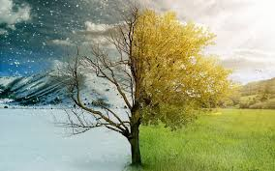
The Cat
Weather is a funny thing

Slide 5

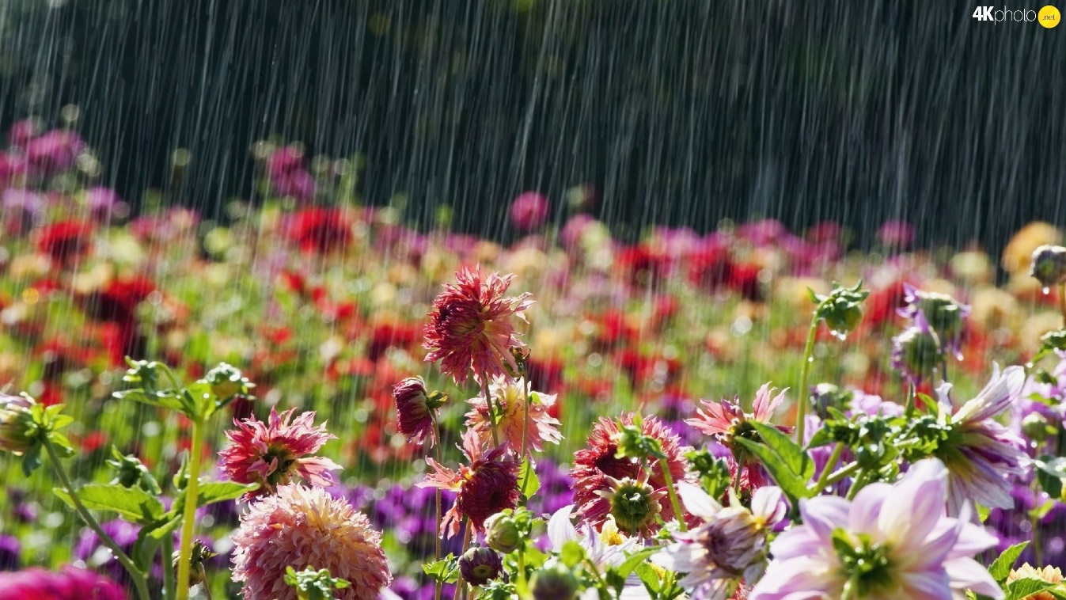
The Elephant
It’s sometimes rainy in the spring.

Slide 6


The Owl
Summer, hot and very sunny

Slide 7

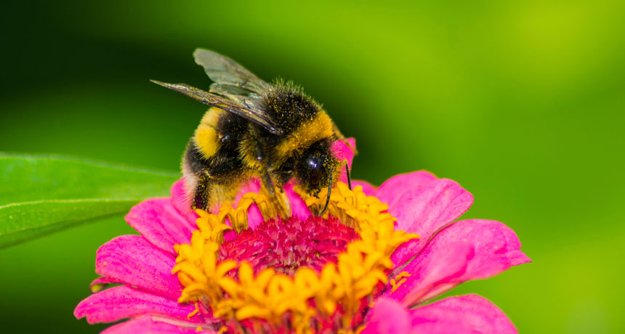
The Butterfly
Flowers bloom and bee’s make honey

Slide 8


The Snake
In Autumn the leaves are falling down

Slide 9

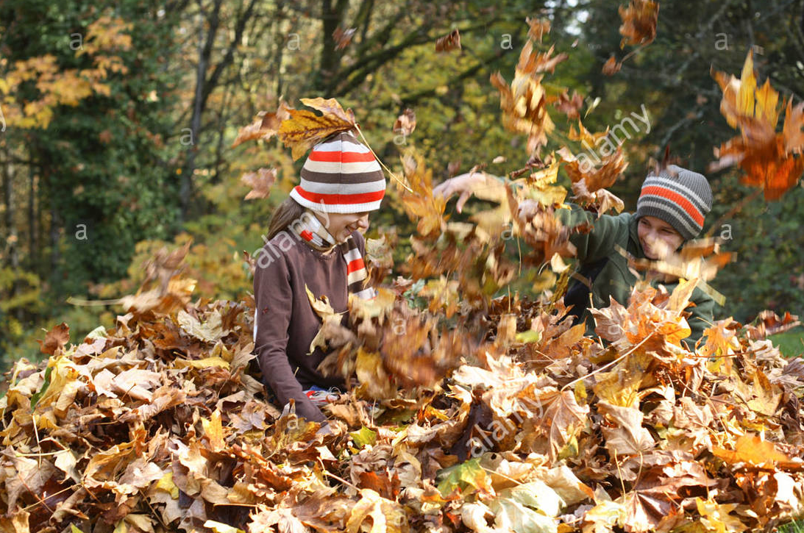
The Frog
Kids jump in piles on the ground

Slide 10

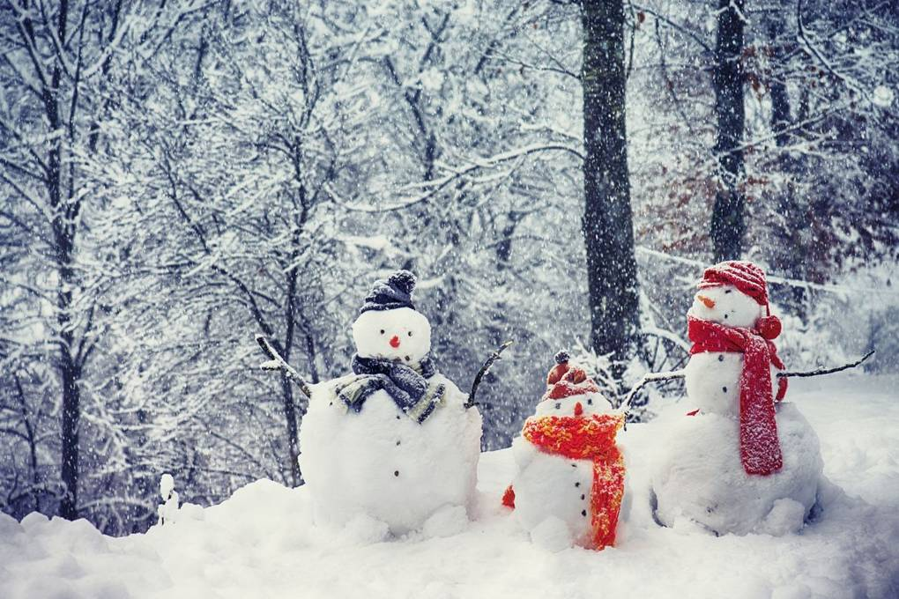
The Ant
Winter brings a lot of snow

Slide 11

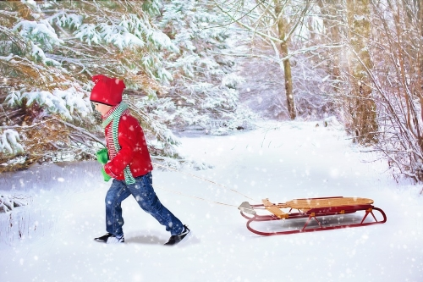
The Swan
So, hop on a sleigh, come let’s go

Slide 12
Say thank you to each other!

