Slide 1
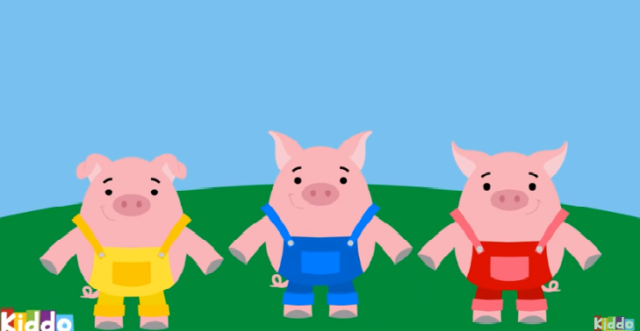
Three Little Pigs

Slide 2

Breathing x3
Breathe in through the nose…hold for 3 seconds…and breathe out slowly and quietly through the mouth.

Slide 3
Ask permission to touch your partner

Slide 4

The Owl
Once upon a time, there were three little pigs. The time had come for them to move out of their mummy’s house and build their own house.

Slide 5

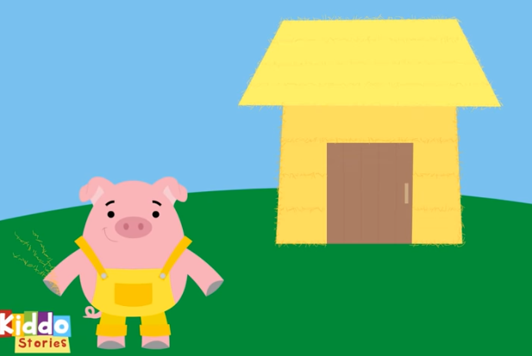
The Snake
The first little pig made his house out of straw.

Slide 6

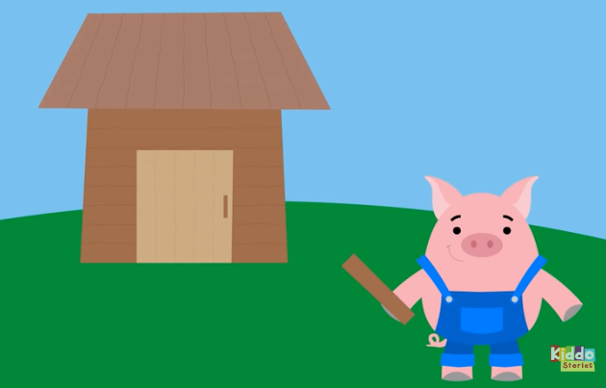
The Ant
The second little pig made his house out of sticks.

Slide 7
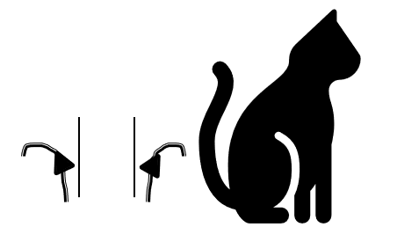
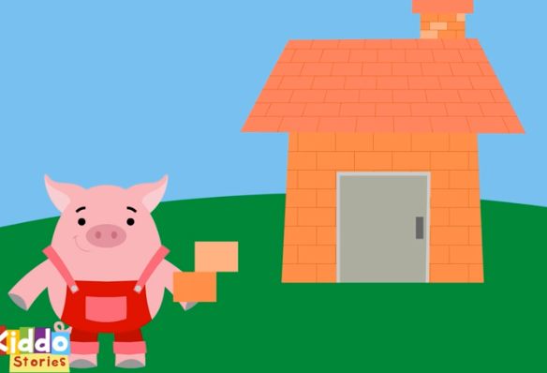
The Cat
And the third little pig made his house out of bricks.

Slide 8

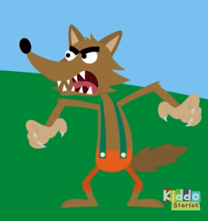
The Frog
Nearby, in the woods, there was a big bad wolf who was very hungry…

Slide 9
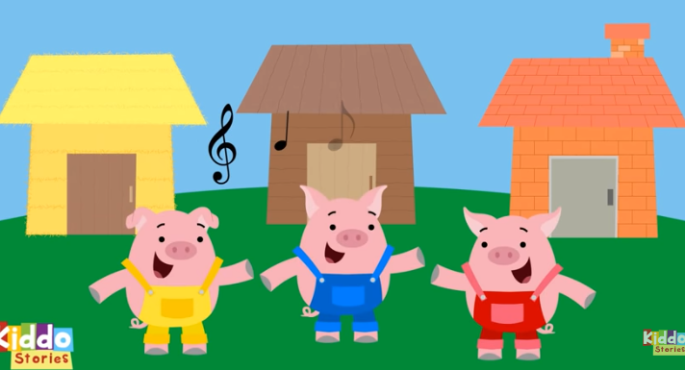
The Ant
Once the pigs houses were finished, the pigs were happy!

Slide 10

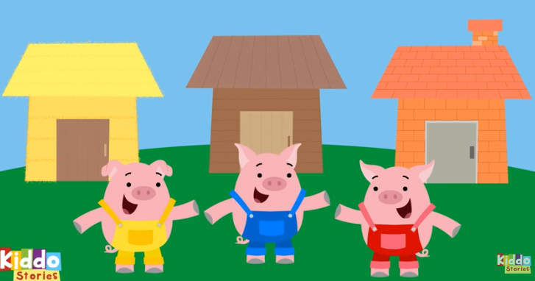
The Bear
The pigs went back to their new homes…

Slide 11

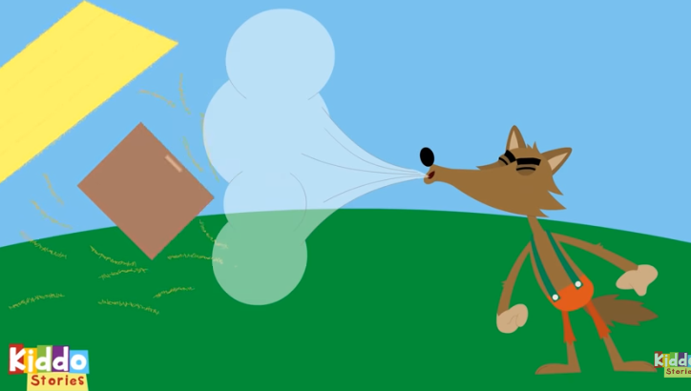
The Elephant
The Big Bad Wolf went to the house made of straw. “Let me in, let me in” said the wolf. “Not by the hair of my chinny chin chin!” said the little pig. “Then I’ll huff, and I’ll puff, and I’ll blow your house in!” said the wolf.

Slide 12
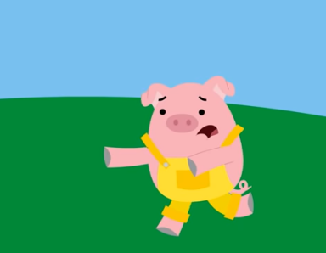
The Bear
The Wolf blew down the straw house but the little pig managed to escape to the house of sticks!

Slide 13
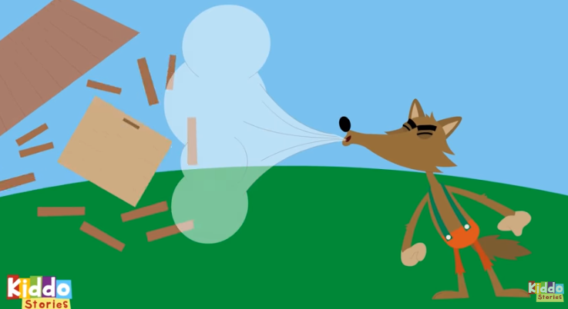
The Elephant
The Big Bad Wolf went to the house made of sticks. “Let me in, let me in” said the wolf. “Not by the hair of my chinny chin chin!” said the little pig. “Then I’ll huff, and I’ll puff, and I’ll blow your house in!” said the wolf.

Slide 14
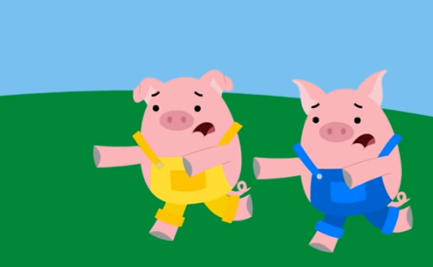
The Bear
The Wolf blew down the stick house but the little pigs managed to escape to the house of bricks.

Slide 15
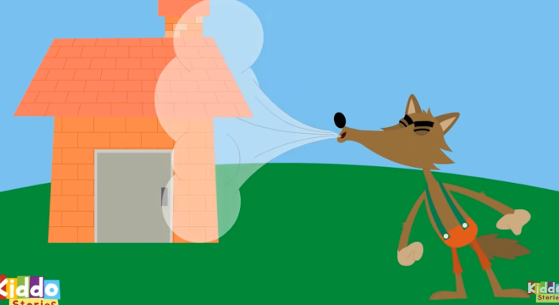
The Elephant
The Big Bad Wolf went to the house made of bricks. “Let me in, let me in” said the wolf. “Not by the hair of my chinny chin chin!” said the little pig. “Then I’ll huff, and I’ll puff, and I’ll blow your house in!” said the wolf.

Slide 16

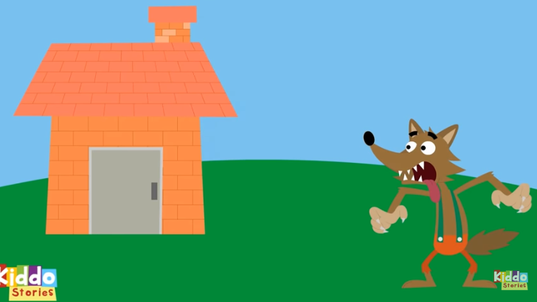
The Butterfly
But…the Big Bad Wolf couldn’t blow down the house made of bricks. It was TOO strong!

Slide 17
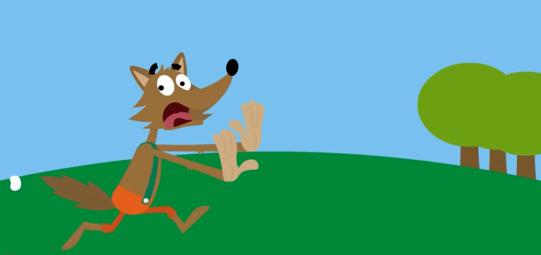
The Frog
The Big Bad Wolf decided to give up and run back into the woods to find food.

Slide 18

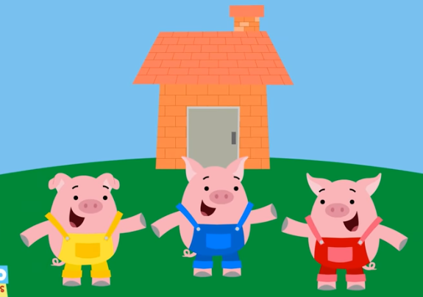
The Snake
The three little pigs never saw the wolf again and lived in the strong, brick house happily ever after.

Slide 19
Say thank you to each other!

