Slide 1
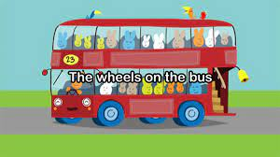
Wheels on the Bus

Slide 2

Breathing x3
Breathe in through the nose…hold for 3 seconds…and breathe out slowly and quietly through the mouth.

Slide 3
Ask Permission to Touch Your Partner!

Slide 4

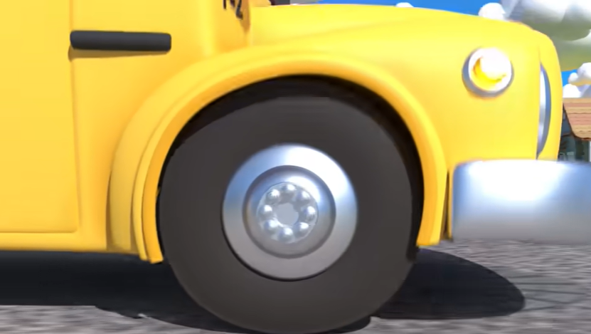
The Owl
The wheels on the bus go round and round, round and round, round and round
The Wheels on the Bus go round and round, all day long.

Slide 5

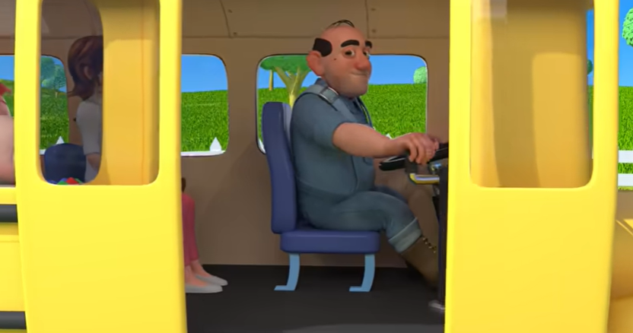
The Butterfly
The doors on the bus go open and shut, open and shut, open and shut.
The doors on the bus go open and shut, all day long.

Slide 6

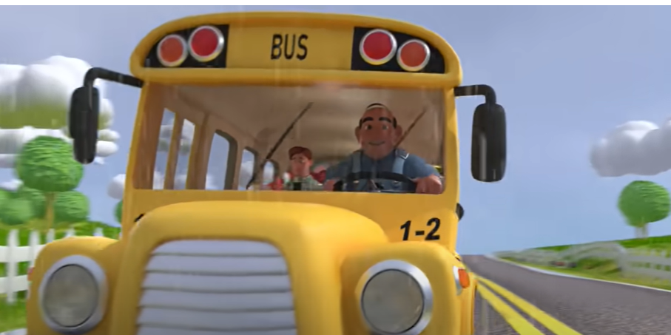
The Snake
The wipers on the bus go swish swish swish, swish swish swish, swish swish swish
The wipers on the bus go swish swish swish, all day long.

Slide 7

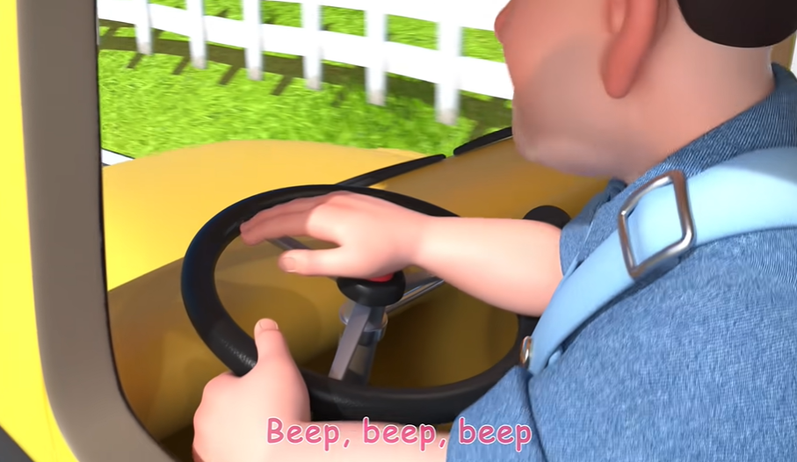
The Bear
The horn on the bus goes beep beep beep, beep beep beep, beep beep beep..
The horn on the bus goes beep beep beep, all day long.

Slide 8
Say thank you to each other!

